Slide 1


NEW WORLD TALENT
Create Winning Talent Strategies
Contact: janice@thescalagroup.co.uk

Slide 2
New World Talent is online
A suite of four interactive online courses
International Talent Management Strategy
Talent Management Implementation
Performance Management
Organize and Manage Coaching and Mentoring and Develop your Coaching Skills
New World Talent is designed for both individual and team learning and collaboration. It can be run as a completely online programme, or suite of programmes, or it can be used as a blended solution with classroom sessions, or private tutorials.
The content is suitable for post-graduate study, or it can serve as a practical guide for HR practitioners, or indeed both.

Slide 3
What is in New World Talent courses?
A mix of practical activities with deep personal learning to help accelerate the modernization of an organization’s processes and includes:
  A companion guide
  A personal tutor/coach
  A toolkit
  A resource library.
Evidence-based options, ideas, and viewpoints, from the authors and other leading sources.
Modules that can be
  split to create micro-learning events,
  kept together to make up a full Masters’ degree (includes assignments for formative and summative assessment),
  a learning/resource center for the organization.

Slide 4
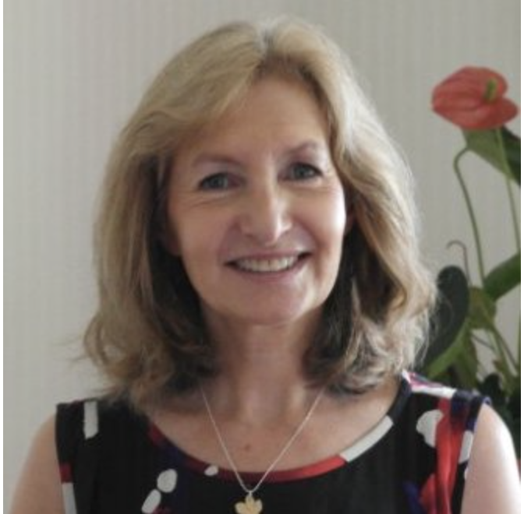
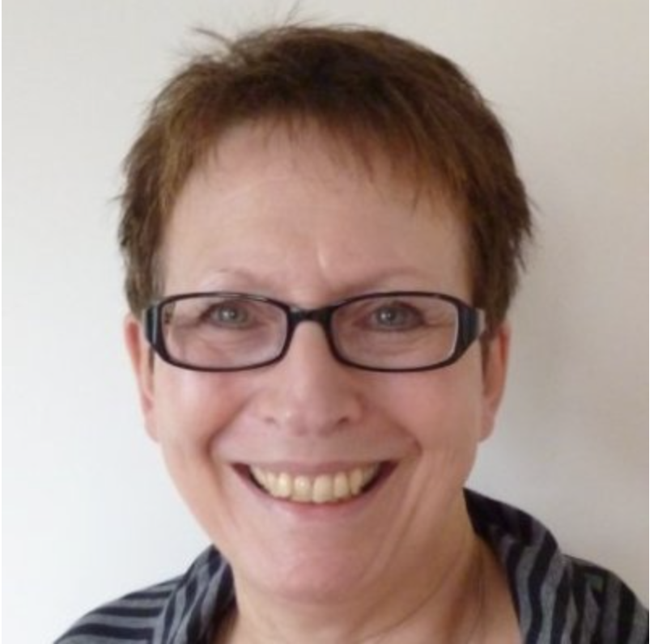
Who are we?
Author
Janice Caplan MA
Hon MBA, CCIPD
An HR Consultant, author, coach-mentor, university governor, HR chair, former CIPD Vice-President. With a Masters’ Degree in HR, and fluent Italian, French and Spanish, Janice works internationally.
Janice’s publications include: Strategic Talent Development (2013), The Value of Talent (2010) both published by Kogan Page, and Coaching for the Future (2003) published by CIPD.
Janice has worked with leading, international organizations on major, often global consultancy projects, and guest lectures at Kingston University London and Moscow, ADEN Business School US and Argentina, and Latam Business School Mexico. Janice’s work has been recognized through various awards including Visiting Professorship Talent Management, Honorary MBA, and the highest HR rank in UK, Chartered Companion of CIPD.
Instructional Designer
Michelle Selinger
MPhil, PhD
A freelance consultant specializing in technology-supported innovation in learning and teaching. She has extensive and acclaimed experience in online and distance learning and has acted as expert consultant and adviser to international agencies including the European Commission, UNESCO, the World Economic Forum Education Initiative, the South African government, and has served as a member of the Australian Federal Minister of Education’s Digital Education Advisory Group.
Michelle has also acted as an education strategy consultant to major IT companies and has recently contributed to the development of a course, Training Teachers to Teach Online.
Previously, Michelle was Director, Education Practice, Cisco Consultancy Services, lecturer in Mathematics Education at University of Cambridge, Lecturer in Education Open University, and Director of Center for New Technologies Research in Education, University of Warwick.

Slide 5
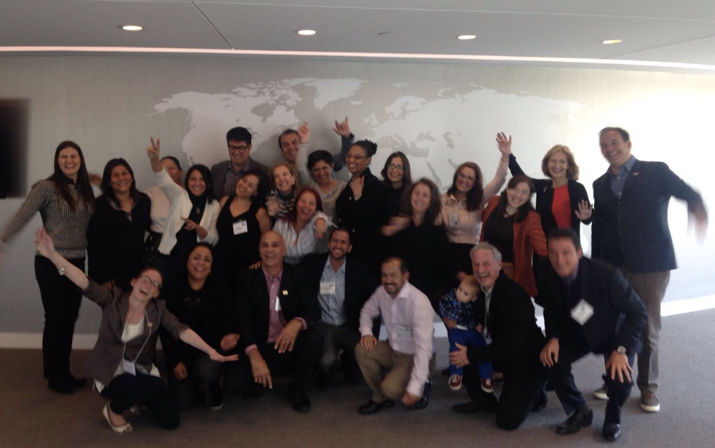

Why is New World Talent different?
It presents topics in many different ways, with options, and not just through video talks to create engaging learning for all learning preferences.
Every topic and every idea are illustrated with real-life examples and case studies.
Extensive resources and templates ready for workplace application
A wide variety of practical exercises and activities to enhance learning and help you at work
An ePortfolio means you can take notes, and develop your organization's action plan whilst engaging with the resources
It can be tailored to a variety of needs e.g. as a basic course, with a practical focus or with an academic focus
It is suitable for team learning and strategy development
Notes:
Do you have a shared understanding of talent management in your organization?
What do people want from talent management? What must it deliver to help achieve business strategy?
How integrated is talent management in your organization? Do your recruitment, learning, promotion, career and reward practices link?
How effectively can people identify career pathways and how to move along these?
What role does your strategic leadership have in talent management?
How well do you know the people you employ? Their skills? Their potential? Their aspirations?`
Can you track their development?
Performance management
Do you understand..
How different attitudes play out in the organization?
The role of non-financial reward?
The trends and pressures for change?
Especially changing structures?
Performance management infrastructure

Slide 6

We are keen to collaborate
A wealth of content
The content can be broken into micro-learning, kept as a suite of four courses, or somewhere in between. You can pick and choose from the content to suit your purposes. We are also happy for you to add your own content, or content of other authors or commentators. We are completely flexible.
Redesign and brand
We have paid much attention to the look and feel of the courses. However, we are happy for the courses to be rebranded, and redesigned.
Regular updating – now updated to Coronavirus era
The courses are all completely up-to-date but new ideas and approaches are being developed all the time. We are happy to find a basis of collaboration where we keep the courses updated for you.
Add-ons
The courses are designed for asynchronous learning. Possible add-ons include, facilitated group working either online, or in a physical classroom, webinars, personal tutoring, marking and assessment of assignments. We are happy to provide these services, if required.
Platform and Learning Management System
The courses are currently hosted on the Canvas platform and have a full LMS . The content can be migrated to your platform if you require.
This Photo by Unknown Author is licensed under CC BY-SA

Slide 7
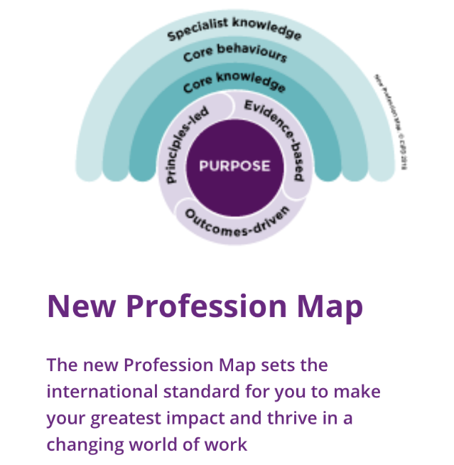
New World Talent aligns with all professional standards
New World Talent aligns with all professional standards
CIPD
The courses align with CIPD, SHRM, HRCI, and CHRP standards
The courses align with all impact levels of CIPD’s new Profession Map, enabling the practitioner to benchmark against the highest standards

Slide 8
The Courses

Slide 9
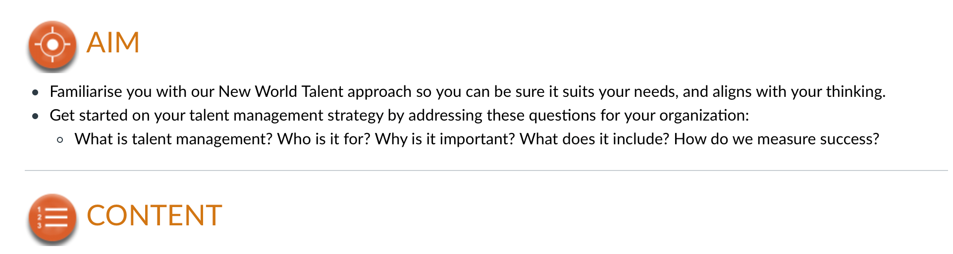

Course 1: International Talent Management Strategy
1.1 What is talent management, and who is it for?
1.2 Why is talent management important?
1.3 Why do we need a strategy for talent management?
1.4 The Four-Point Framework
1.5 Let’s draw up your talent strategy
1.6 How do we measure success?

Slide 10
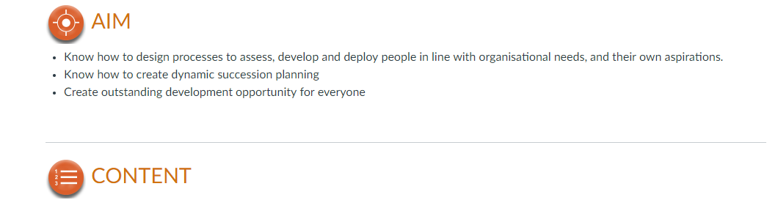

Course 2: Implement New World Talent
Know how to design processes to assess, develop and deploy people in line with organizational needs and their own aspirations
Know how to create dynamic succession planning
Create outstanding development opportunity for everyone
2.1 Overview and recap of New World Talent
2.2 How to make talent management inclusive
2.3 How to identify talent for specific needs, such as future leaders
2.4 Dynamic succession planning

Slide 11
Course 3: Performance Management
Gain a background understanding of how to create a high performance organization
Draft an effective performance appraisal process for your organization
Be ready to steer your organization towards a high performance culture
3.1 Overview of performance management
3.2 Change and review current practices
3.3 Performance management infrastructure
3.4 Self-management of performance
3.5 Pay and forced ranking
3.6 Development planning
3.7 Review of course and two case studies to consolidate learning

Slide 12
Course 4: Coaching and Mentoring
To aid HR professionals to organize coaching and mentoring in their organizations. The module provides templates, guidance, training materials, and case study examples.
There is a practical, self-development module for managers and others to develop their coaching skills, and handle difficult conversations.
4.1 Develop your coaching skills (for managers wishing to use basic coaching skills in their everyday interactions
4.2 Managing and organizing coaching and mentoring
4.3 Internal mentoring
4.4 Managing the coaching process
4.5 Train the trainer

Slide 13
Methodology

Slide 14
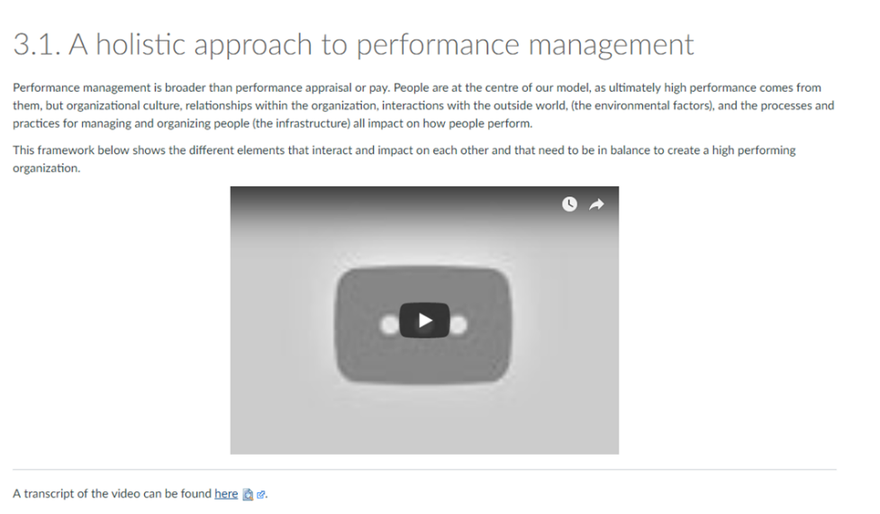
Topic
The discussion often presents different viewpoints, sometimes giving the option to watch a video, listen to audio or read the text

Slide 15
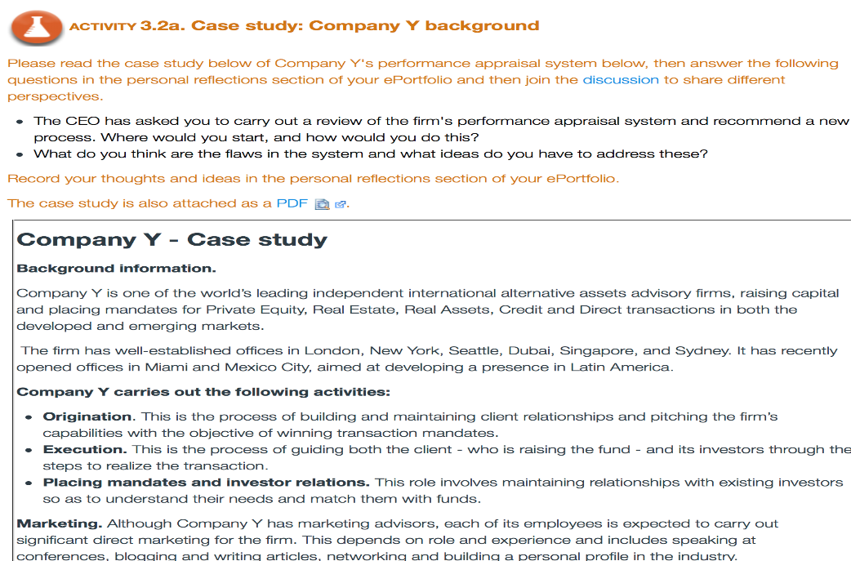
Case studies and scenarios
Each topic is illustrated with real-life case studies or scenarios

Slide 16
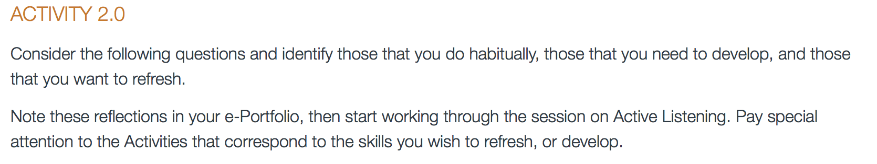
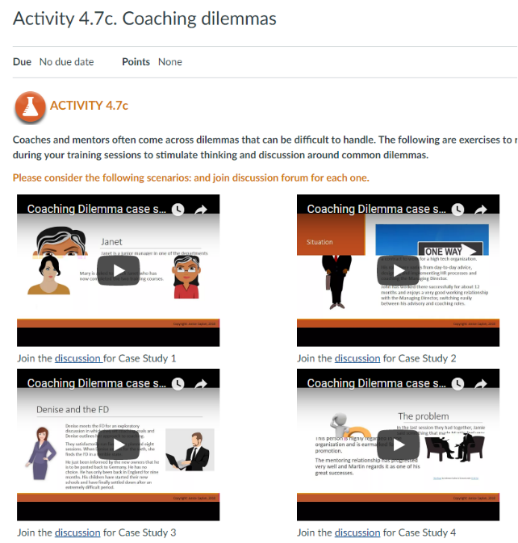
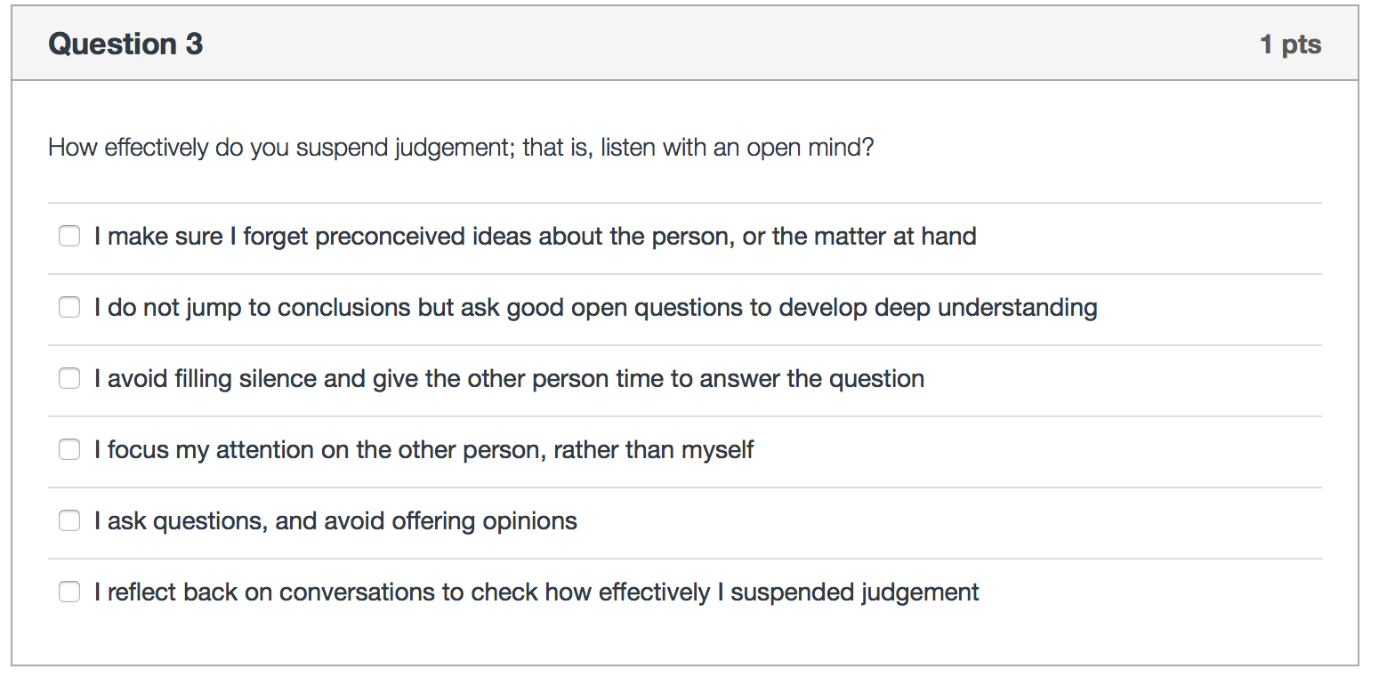
Activities
Followed by Activities to complete: practical exercises to implement in the workplace: reflective exercises: self-awareness questionnaires, or case study assignments (students)

Slide 17


Reflection and Action
At the end of the discussions and activities of each topic, there is a Reflection and Action page.
REFLECTION
Key learning points from the session are summarized here
Learners are guided to create action plans for implementation at the workplace
ACTION

Slide 18

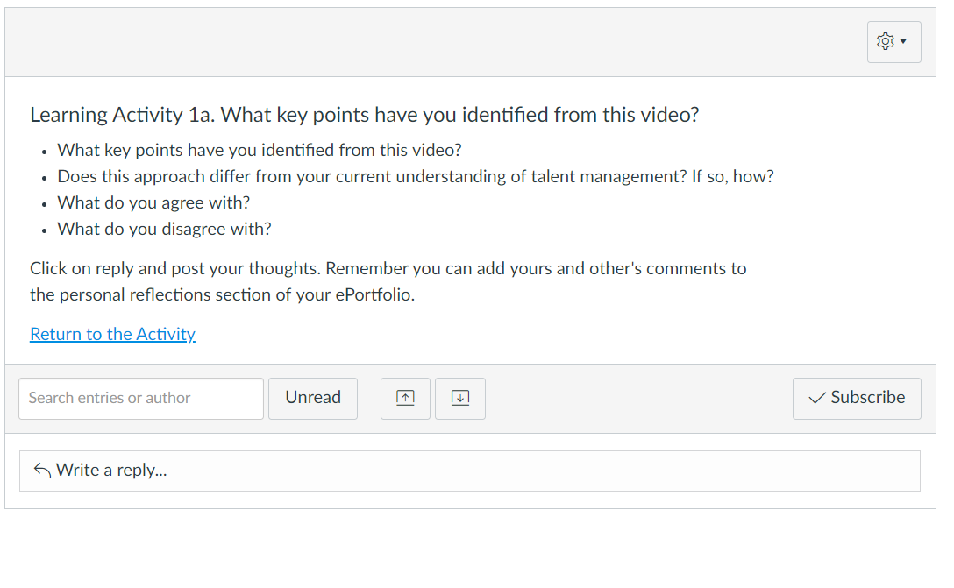
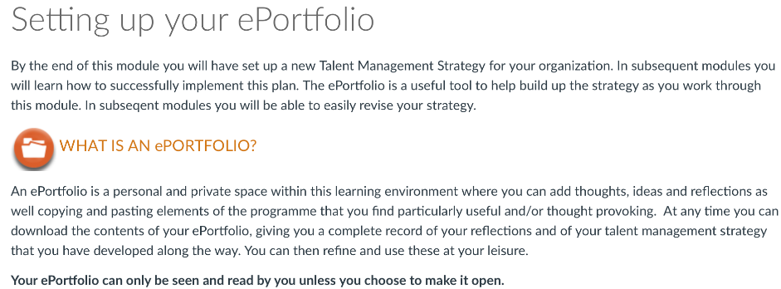
ePortfolio and Discussion Forums
ePortfolio Discussion Forum
The ePortfolio can be accessed at any time, and from any place. Here learners record their responses to the Activities, make notes, and also create their personal development plans.

Slide 19

Action Plans
The course is interactive:
Students develop ideas for an Action Plan as they progress through a course
They take the actions and reflections from their ePortfolio and pull them into an implementable Action Plan to take to their board
This Photo by Unknown Author is licensed under CC BY-NC

Slide 20
Components of the online toolkits
The resources include:
Research evidence and ideas from exemplary practice
Video interviews on key areas
Slides on important issues
Case studies to exemplify a position or to analyze & suggest solutions to business challenges
Activities that help to consolidate understanding and apply it to a student’s own organization
Quizzes and checklists to ascertain a position or to check understanding of a particular area
Downloadable templates to use with colleagues in a participant’s organization
Discussion forums with other participants
Webinars with the author (optional)
A personal ePortfolio to store personal reflection and to build Action Plans
Further reading to deepen and broaden participants’ knowledge
A full Learning Management System to enroll students and keep track of their progress
How you learn is as important as what you learn

Slide 21
Thank You
NEW WORLD TALENT
Create Winning Talent Strategies
Contact: janice@thescalagroup.co.uk

